Slide 1
School of Aeronautics PLACEMENT PRESENTATION
LEADERS IN AVIATION EDUCATION INDUSTRY
25 YEARS OF GLORIOUS SERVICE TO AVIATION INDUSTRY
2018-19

Slide 2
THE INSIDE
Introduction Vision and Mission Academic Program & Accreditation Teaching & Faculty Laboratories Library Extra Curricular Activities Recent Achievement & Honor Internship Project Publication Industry Interface & Past Recruiters (Alumni) Practice School: The Institute - Industry Linkage Research & Development

Slide 3
Introduction about School of Aeronautics
Approved By AICTE, DGCA, Affiliated to RTU, Kota & Licensed By EASA

Slide 4
ABOUT SCHOOL OF AERONAUTICS
School of Aeronautics was established in 1992, since then we are into providing world class Aviation Education, in various disciplines.
After successfully running School of Aeronautics (Delhi) for 14 years, School of Aeronautics (Neemrana) was established in 2006. It is situated in NCR on New Delhi - Jaipur, National Highway No. 8. The functional & technical infrastructure is operational on sprawling 5 acres campus set in serene environment.

Slide 5
Vision & Mission

Slide 6
THE VISION
"To make every man a success and no man a failure."
THE MISSION
To provide every individual with a conducive environment suitable to achieve his/her career goals with a strong emphasis on personality development and to offer the academically inclined resources to gain quality education in all spheres of engineering, applied sciences and management, without compromising on the quality and code of ethics of each student of the institution.

Slide 8
OUR ACADEMIC PROGRAMS
B. Tech (Aeronautical Engineering), 4 Yrs Duration.
The course curriculum of Aeronautical Engineering is made up of maintenance as well as design aspect of the present day aviation and aerospace engineering. It prepares graduates with knowledge, problem solving ability, hands-on skills to enter career in the design, installation, manufacturing, testing, evaluation, Quality Control & Planning, technical sales, and Maintenance of Aircraft System.
Aircraft Maintenance Engineering , 3 Yrs Duration.
The course curriculum of Aircraft Maintenance Engineering is made up for Avionics System of the Aircraft. Students are given hands on experience on testing and calibration of Aircraft Avionics Components.

Slide 9
Teaching & Faculty

Slide 10
TEACHING & FACULTY
Innovative teaching methodology results in outstanding performance by the students and is fed by informed research.“
It is a well known fact that students can learn more effectively when actively involved in the learning process.
We have developed a unique approach of teaching, development and delivery with continuous research.

Slide 11
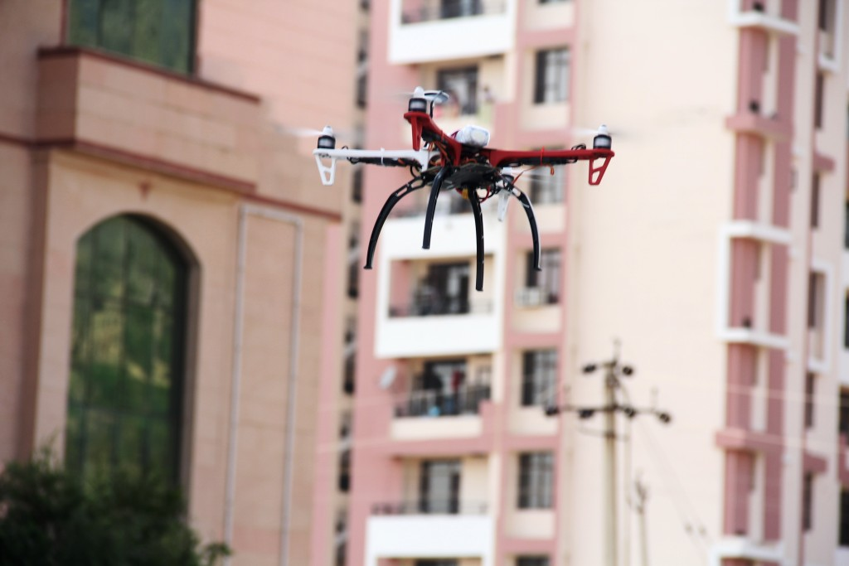
Laboratories

Slide 12
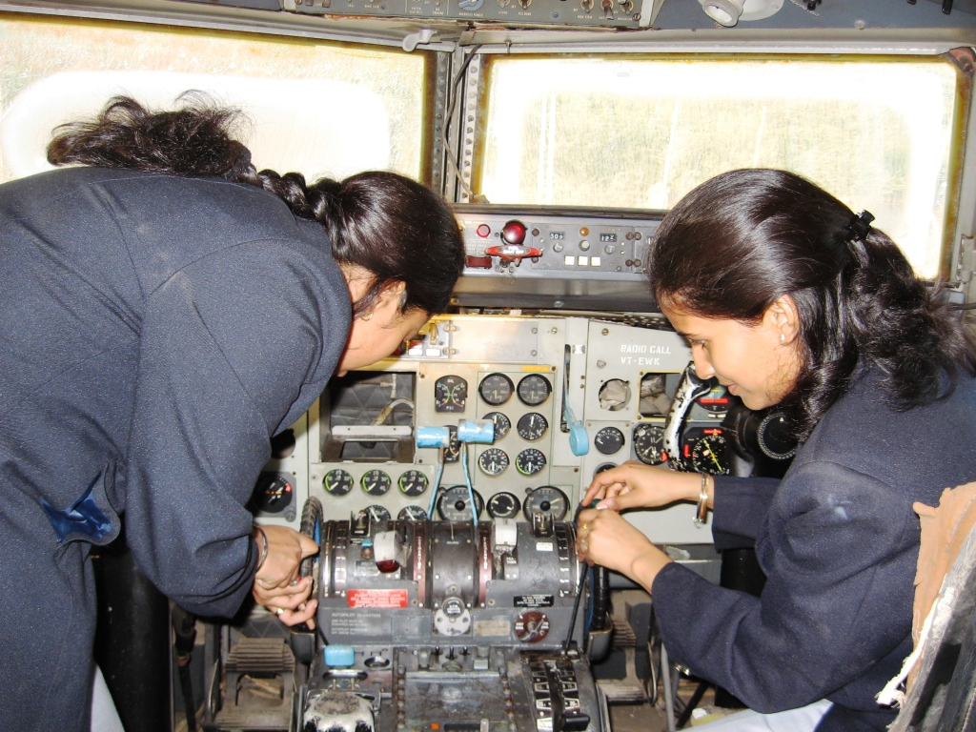

Slide 13
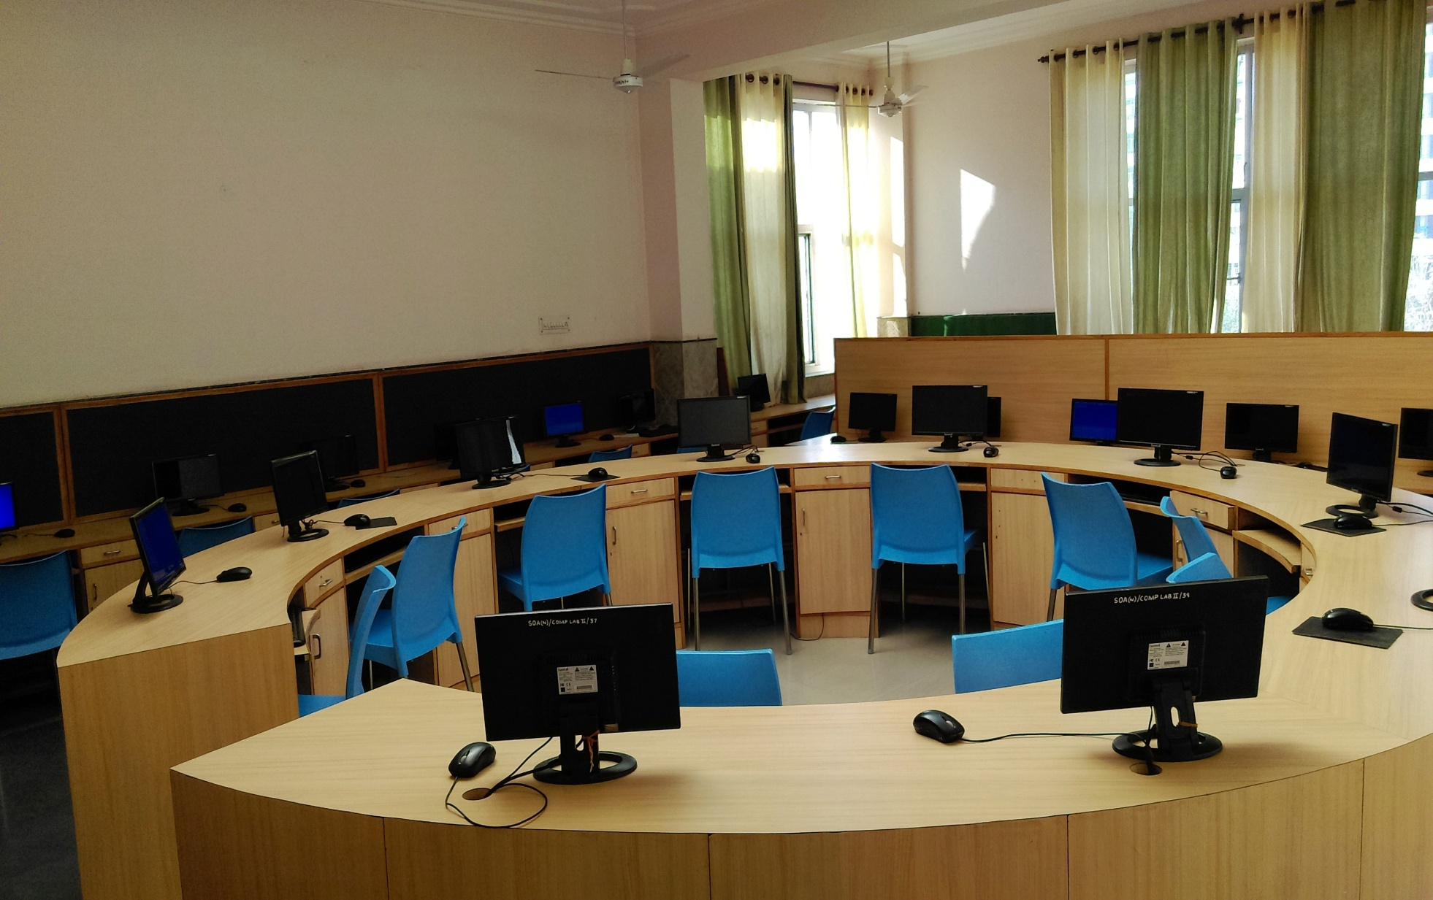

Slide 14
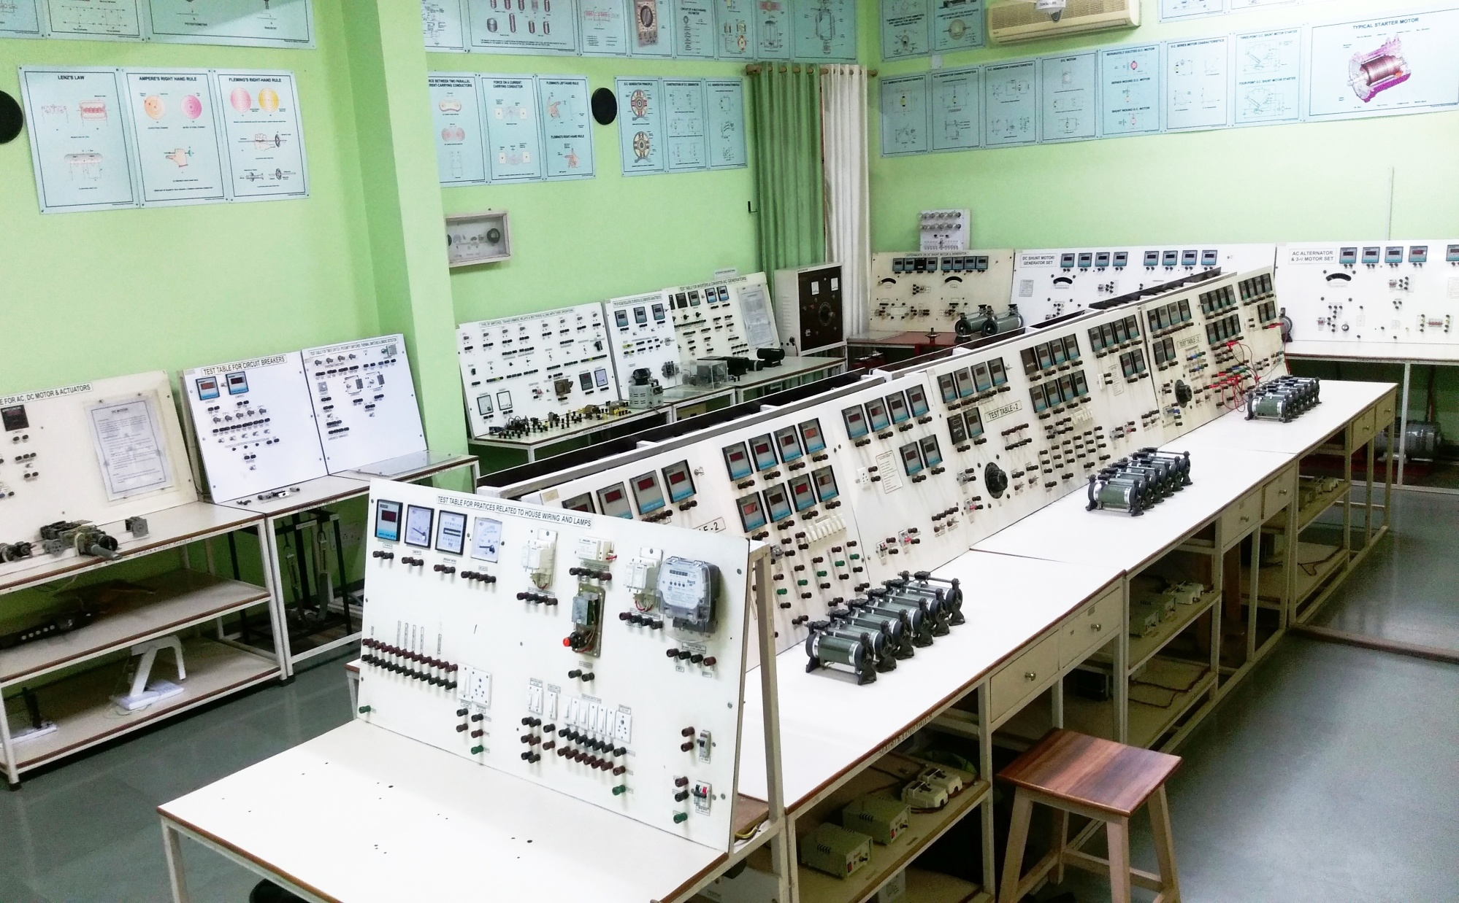

Slide 16
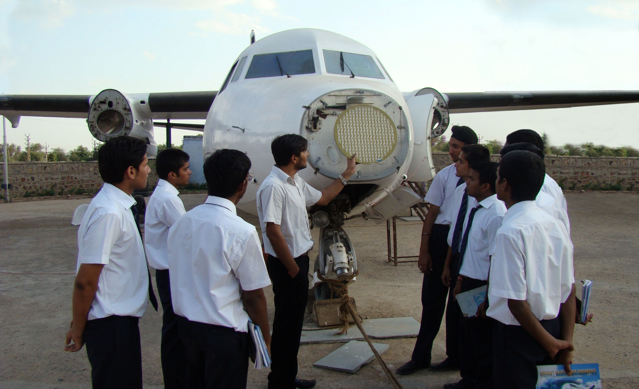

Slide 17
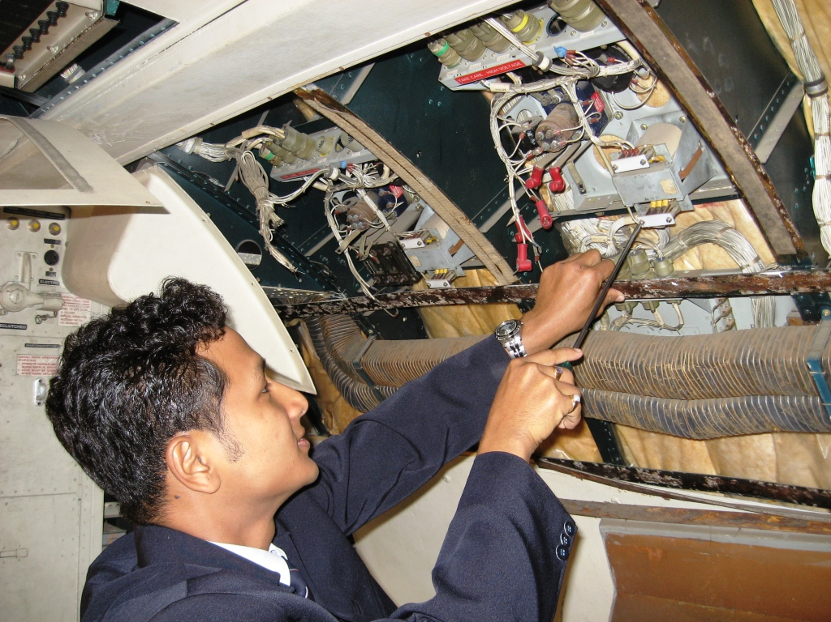

Slide 18
LABORATORIES
Practical training is an essential part of any engineering course. The institute has a well equipped workshop to impart practical training to students in basic workshop technology. The other laboratories include
Aircraft Electrical lab
Aircraft Instrument lab
Radio & Navigation System lab.
Airframe Lab
Engine Lab
Aircraft Instrument Calibration Lab
Wind Tunnel Lab
Aircraft Structure Lab
Strength of Material Lab

Slide 19
Material Testing Lab
Thermodynamics Lab
Fluid Mechanics Lab
Physics Lab
Chemistry Lab
Computer Lab
Language Lab
Basic Electronics Lab
Basic Electric Lab
Aircraft Battery Overhaul Shop
Aircraft Engine Test Lab
These labs are equipped with all required training aids and other equipments required for practical demonstration and training.

Slide 20
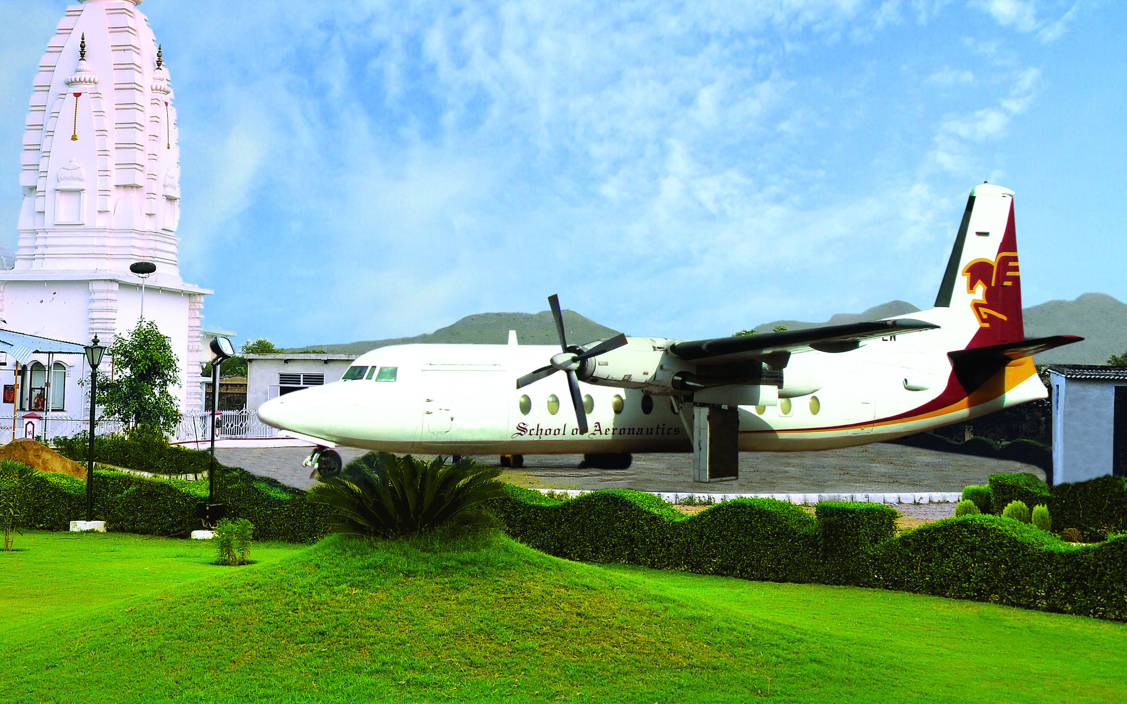
Our Aircrafts

Slide 21
OUR AIRCRAFTS FOR TRAINING TO STUDENTS
School of Aeronautics has two 52 seater fully serviceable Aircrafts for training to students.
All the Mechanical and Avionics systems of the Aircraft are serviceable.
Trained faculty members are providing, specially designed modules to the students during their practical's and OJT.

Slide 22
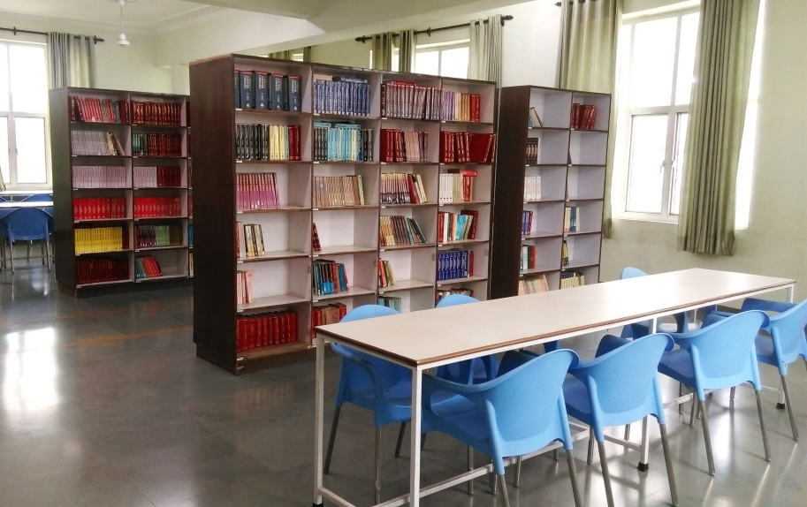
College Library

Slide 23
COLLEGE LIBRARY
Fully equipped library with numerous
Course text books,
Reference books,
Solved/unsolved exam papers,
News I bulletins, magazines,
Personality development books,
General knowledge and
Competitive exam books

Slide 24
MAGAZINES, JOURNALS AND e-BOOKS
The library also receives a number of popular magazines and current aviation journals. Our institute also has collaboration with other libraries
Our library has national as well International Journals in e-form and hard copies. Total number of e-books are approximately 32000, books in hard bonding are more than 14000.
OUR LIBRARY IS SPREAD OVER 410 SQ MTS OF AREA

Slide 25
Extra Curricular Activities

Slide 26
EXTRA CURRICULAR ACTIVITIES
The College's Physical Recreation & Sports Facilities offer an exciting range of sporting opportunities for both students and staff.
The philosophy behind this is to stay healthy, raise confidence and compete like Yoga, Tennis, Badminton etc.
The technical associations of the various disciplines play an active role in organizing discussions, seminars, guest lectures, educational tours etc.
Various clubs of college keep on organizing events as per schedule.

Slide 27
RECENT ACHIEVEMENTS & HONOR

Slide 29
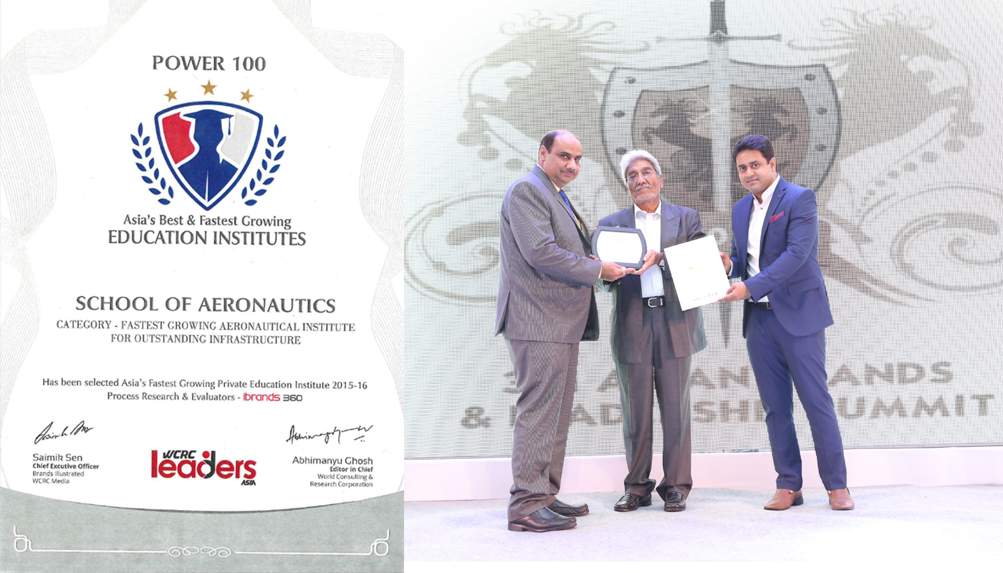

Slide 31
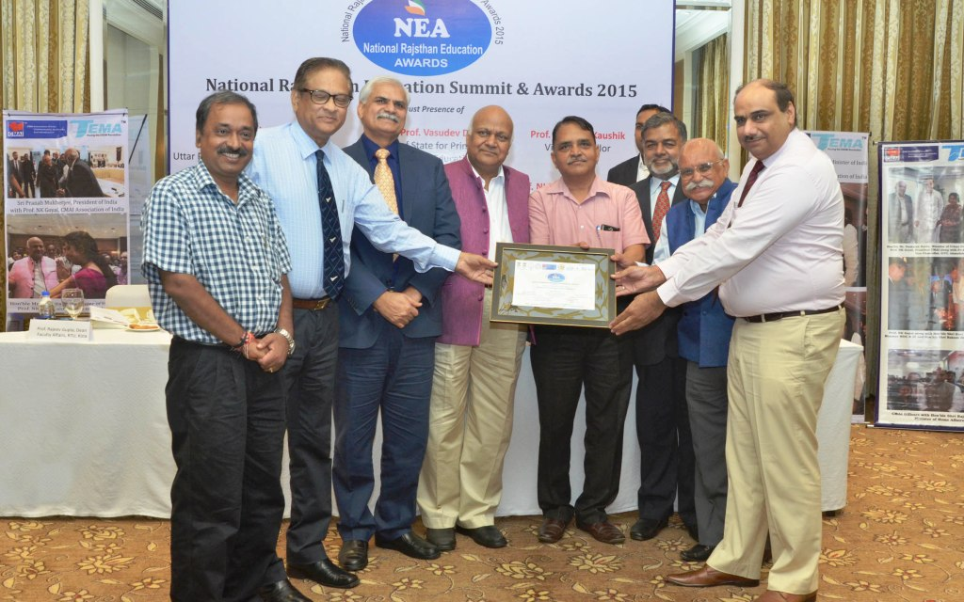

Slide 33
INTERNSHIPS
Mandatory fifty days internship in department specific industry to gain hands on experience in the third year of undergraduate study. Apart from this, frequent industrial visits and training sessions are organized for the students.

Slide 34
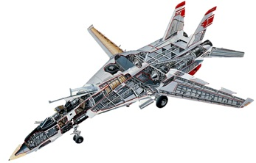
Students Projects

Slide 35
STUDENTS PROJECTS
Students undertake various interdisciplinary-research and industrial projects under the guidance of the faculty solving real-life problems pertaining to research and the industry. Moreover, the B.Tech students have to complete a 'Thesis Project' in the final year of their Engineering course.

Slide 36
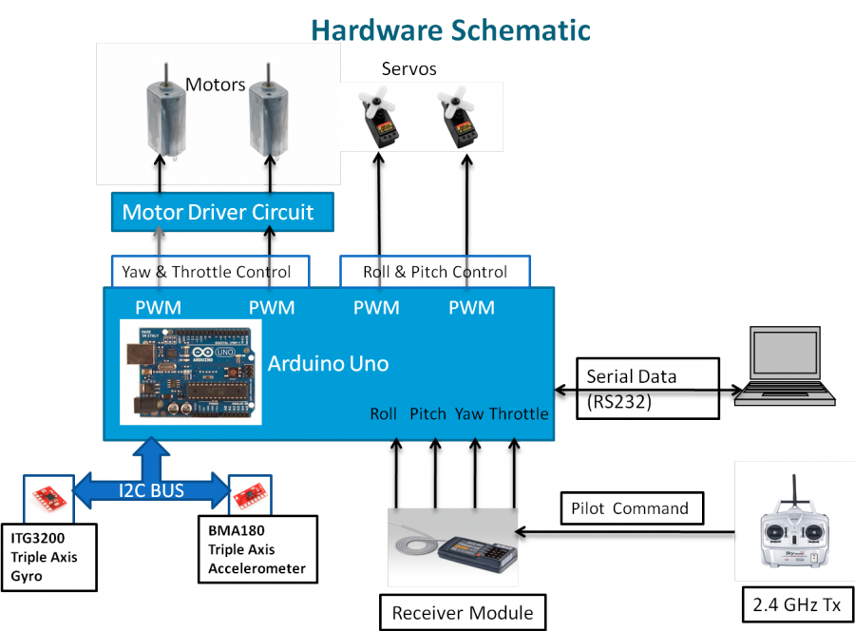
Publications

Slide 37
PUBLICATIONS
Students actively publish their work in the form of research papers in reputed national and international conferences and referred journals

Slide 39
PRACTICE SCHOOL: THE INSTITUTE INDUSTRY LINKAGE
The Practice School (Industrial Training) component is inducted into the course structure and almost all the students undergo this component which provides them a thorough exposure to the core industry and corporate experience.
All students are required to complete a one and a half month training during the summers of their third year in industry.
This is a unique and innovative strategy to groom the students while gradually exposing them to the corporate and research world.
Almost all the major corporate, research facilities, institutes and well-known organizations are Practice School stations for SOA.

Slide 40
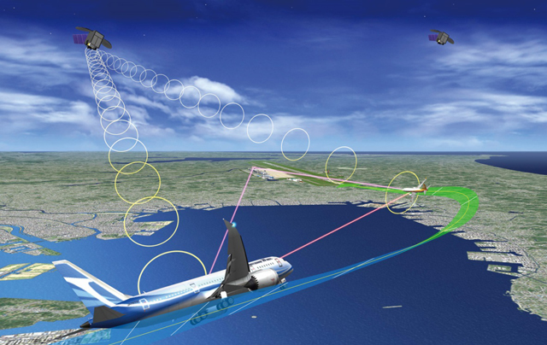
Research & Development

Slide 41
RESEARCH & DEVELOPMENT
SOA has a number of well equipped laboratories with state of the art facilities.
Students gain valuable experience in the forefront of scientific research through project type courses and thesis work.

Slide 42
All Round Development of Students

Slide 43
ALL ROUND DEVELOPMENT OF STUDENTS
The Institute provides all the required facilities for sports and recreation to ensure overall development of every student.
Students operate various clubs existing on the campus for example Dance I Drama and Music Club, Book Club, Innovation Club, Sports Club, Green Club, Meditation & Yoga Club, Social Club, Technology Club, Seminars & Events
Internal organizations like the SOA Alumni Association, the Centre for Software Development, Centre for Entrepreneurial Leadership etc. at campus are all run responsibly by students of various years and batches in a professional manner.

Slide 44
The Students' Activity Centre is the nerve centre of all student activities on the campus. A number of literary and social activities take place on the campus through out the year.
Each year students organize an Inter-College, national level, Techno cultural meet called 'AERO TECHNOCULTURAL FEST’.
SOA's educational system puts ample opportunities for development of Soft skill & Emotional Intelligence.
Many courses have mandatory class room presentation and group discussion components which help improve communication skill.
Many students learn foreign languages by enrolling in external courses like German, French etc., off campus

Slide 45
Our Alumni

Slide 46
OUR ILLUSTRIOUS ALUMNI
Our alumni find themselves in all areas of engineering and academia. Whether they have been part of our undergraduate or AME programs (or both), our students are prepared to enter the world as practiced professionals.
Details of some of the alumni are as follows:

Slide 47
Sl. No. | Name | Qualification | Designation | Organization
1 | Rahul Pandey | B.Tech Aeronautical | Executive Vice President | Aric Airlines
2 | Sonica | B.Tech Aeronautical | Flight Leiu | Indian Airforce
3 | Sonia Goel | B.Tech Aeronautical | Design & Estimation Engineer | Honey Well International
4 | Sherya Gupta | AME | Safety Manager | Air India
5 | Eusebious Chulli | B.Tech Aeronautical | Asst. Prof.& Research Scholar | Hindustan University
6 | Dipanker Roka | B.Tech Aeronautical | Business Consultant | Nichebees Techno Solution
7 | Vineet Mohali | B.Tech Aeronautical | Design Engg. | DURR System
8 | Rahul Singh | B.Tech Aeronautical | Project Engg. | SMCS Pvt. Ltd
9 | Sanjeev kumar | B.Tech Aeronautical | Sr. Manager, ERP | KENMORE Vikas India Pvt. Ltd
10 | Manoj kumar | B.Tech Aeronautical | Asst. Commandant | Coast Guard
11 | Dwebendu Kusahu | B.Tech Aeronautical | Asst. Professor | RV University

Slide 48
Sl.No. | Name | Qualification | Designation | Organization
12 | Sujeeta | B.Tech Aeronautical | Sr. Engineer | GMR Aerotech Ltd.
13 | Anil Jaiswal | B.Tech Aeronautical | Deputy Manager | Mahendra & Mahendra
14 | Rima Roy | B.Tech Aeronautical | Sr. Engineer | GMR Aerotech Ltd
15 | Chetan Prakash | B.Tech Aeronautical | Design Engg. | Infotech Enterprises Ltd
16 | Manoranjan | B.Tech Aeronautical | Sr. Planning Engg. | Jet Airways
17 | Prasana Sidhartha | AME | Executive | Indigo
18 | Rohit Kumar | AME | IFE Engineer | Panasonic
19 | Kinsuk Sikri | AME | Maintenance Engg. | Jet airways
20 | Anshul Soni | AME | Sr. Manager | Indigo
21 | Ashish Mathur | AME | Asst. Manager | Airbus
22 | G.Sameer | AME | Maintenance Engg. | Qatar Airlines

Slide 49
Sl.no. | Name | Qualification | Designation | Organization
23 | Parwaiz Alam | AME | Manager MCC | Indigo
24 | Gourav Dhingra | B.Tech Aeronautical | Asst. Manager | GMR
25 | Azim Aijaz | B.Tech Aeronautical | Asst.Professor | Trinity Institute of Technology & Research

Slide 50
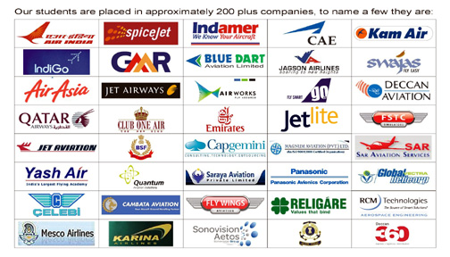
OUR PAST RECRUITERS

Slide 51
FOR STUDENTS PROFILES
Please see our placement brochure on college website OR
Visit our website - www.soaneemrana.org
www.soaneemrana.com
CONTACT US
Mr. C.C. ASHOKA (Director)
Mobile – 9314009020, 9350209008
E-Mail – ccashoka@gmail.com

Slide 52
CORPORATE OFFICE
SCHOOL OF AERONAUTICS
H 974, Palam Extension, Part 1, Sector 7
Dwarka, New Delhi 110077
Phone: 08800228720, 9311209012
NEEMRANA CAMPUS
SCHOOL OF AERONAUTICS (NEEMRANA)
I - 04, RIICO Industrial Area,
Delhi- Jaipur Highway NH -8
Neemrana, Rajasthan
Phone: 9314009020, 9314009035
CAMPUS PLACEMENT PROGRAM CAN BE ARRANGED AT ANY OF THE LOCATIONS AS PER CONVENIENCE

Slide 53
THANKS FOR YOUR VALUABLE TIME

